Slide 1
Influence of different chloride ion
concentration on corrosion of rebar
菂
Qingrui Wang
2017.09.21

Slide 2
outline
First
Second
Third
Last
Introduction
Raw materials
and equipment
Results and analysis
conclusion

Slide 3
Introduction

Slide 4
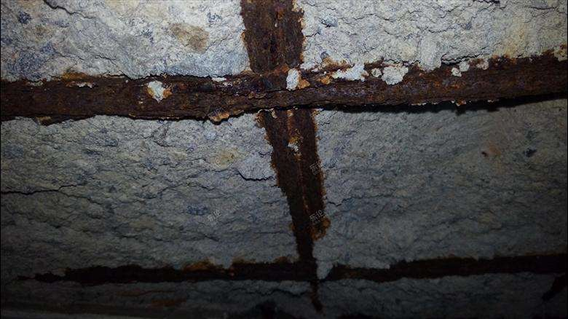
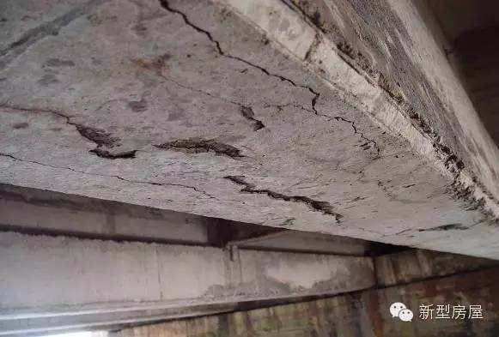
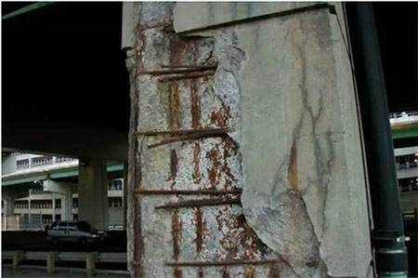
Introduction
Reinforced concrete is the most commonly used building material, however, the most important factor affecting its service life is the corrosion of steel bars。Therefore, it is of great significance to study how to avoid the corrosion of steel bars.
In this experiment, we mainly study the corrosion of rebar in chloride ion environment.

Slide 5
Introduction
1.The reinforcing bars were soaked in six groups of saturated calcium hydroxide solutions with chloride concentrations of 0.02%, 0.04%, 0.06%, 0.12%, 0.25% and 0.5%.
2.Every week using an electrochemical workstation,obtain the the Tafel curve and other electrochemical data.
这里填写文字内容这里填写文字内容
这里填文内容里填写文字内容
这里填写这里填写文字内容
3.Analyzing its electrochemical data and appearance changes can draw the conclusion

Slide 6
Raw materials and equipment

Slide 7
Raw materials and equipment
Q235 reinforcement
calcium hydroxide
sodium chloride
distilled water

Slide 8
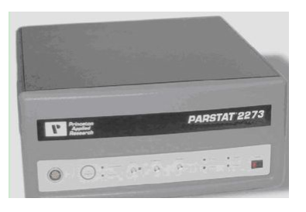
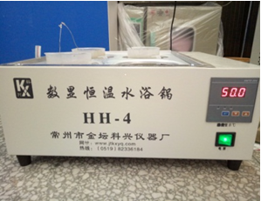




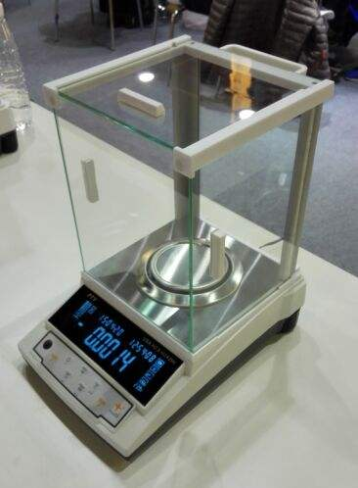


Raw materials and equipment
1.Electrochemical workstation
3. Thermostat water bath
2.Electronic balance

Slide 9
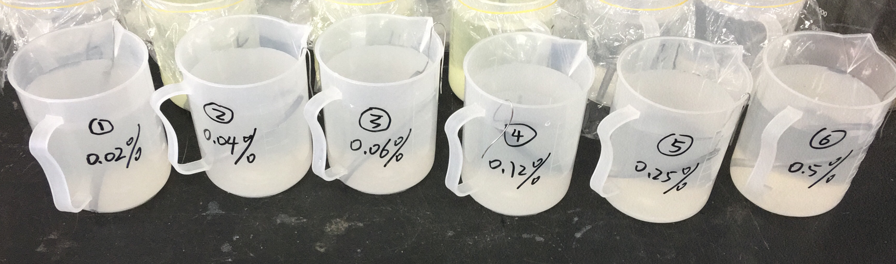
Raw materials and equipment
1
4
Prepare six groups of solutions with different chloride concentrations
Tafel curve
2
(EIS)Electrochemical impedance spectroscopy
5
Experiments at different temperatures
3
Linear polarization curve
6
Draw with Origin

Slide 10
Results and analysis

Slide 11

Results and analysis
Nyquist
The first week
The third week
time
1
The fifth week
The eighth week
Change
the solution
The chloride concentration was 0.02%

Slide 12
Results and analysis
Linear polarization curve
The first week
The third week
time
1
The fifth week
The eighth week
Change
the solution
The chloride concentration was 0.02%

Slide 13
Results and analysis
Tafel curve
The first week
The third week
time
1
The fifth week
The eighth week
Change
the solution
The chloride concentration was 0.02%

Slide 14
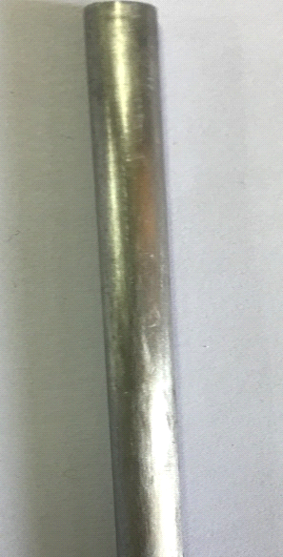
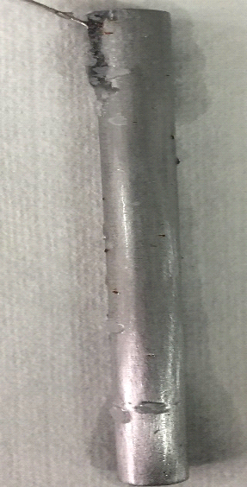
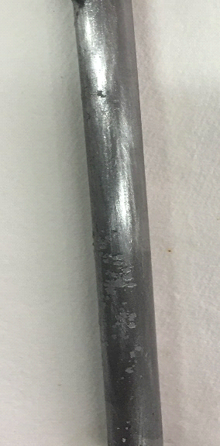
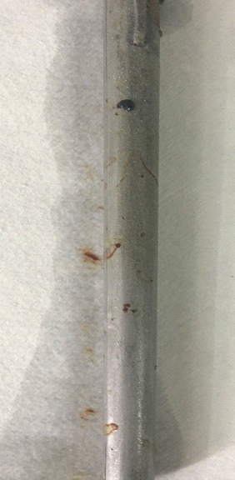
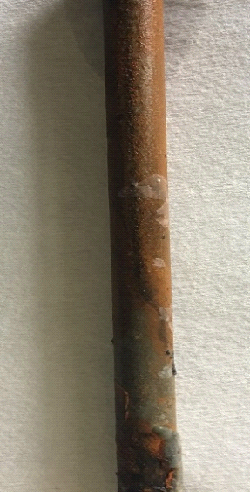
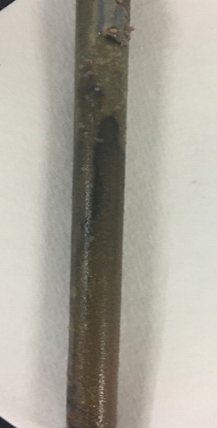
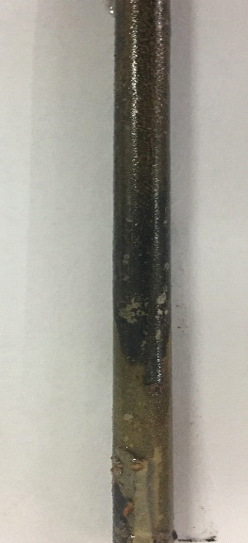
Results and analysis
Appearance change
time
1
The change of steel bar and solutions from first week to the eighth week.

Slide 15

Results and analysis
Nyquistc
The first cycle
concentration
2
The eighth cycle

Slide 16
Results and analysis
Tafel curve
The first
cycle
concentration
2
The eighth
cycle

Slide 17
Results and analysis
Appearance change
concentration
2
The first cycle
The fifth cycle
The third cycle
The eighth cycle

Slide 18
Results and analysis
Appearance change
concentration
2
The fifth cycle
The eighth cycle

Slide 19
Results and analysis
Appearance change
concentration
2
The fifth cycle
The eighth cycle

Slide 20

Results and analysis
Nyquist
20℃
30℃
temperature
3
40℃
50℃
The chloride concentration was 0.12%

Slide 21
Results and analysis
Tafel curve
temperature
3
The chloride concentration was 0.12%

Slide 22
Results and analysis
Appearance change
temperature
3
The appearance change of steel bar and solutions from 20℃ to 50℃

Slide 23
conclusion

Slide 24
conclusion
Time
1
With the passage of time, the ability of reinforcing steel to resist corrosion becomes weaker, and the corrosion of reinforcing steel is more and more serious
Concentration
2
The higher the chloride concentration is, the weaker the resistance of steel to corrosion is, the worse the corrosion of reinforcing steel is
Temperature
3
With the increase of temperature, the weaker resistance to corrosion of steel, corrosion becomes more serious

Slide 25
Thank you

